Slide 1
StreamTokenizer
The Java StreamTokenizer class (java.io.StreamTokenizer) can tokenize the characters read from a Reader into tokens.
When you are parsing files or computer languages it is normal to break the input into tokens, before further processing them. This process is also called "lexing" or "tokenizing".
Using a Java StreamTokenizer we can move through the tokens in the underlying Reader. We do so by calling the nextToken() method of the StreamTokenizer inside a loop. After each call to nextToken() the StreamTokenizer has several fields you can read to see what kind of token[word, number, end of line] was read, it's value etc.
Peter
had
1.0
pen.
Peter had 1 pen.

Slide 2
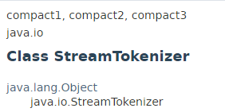
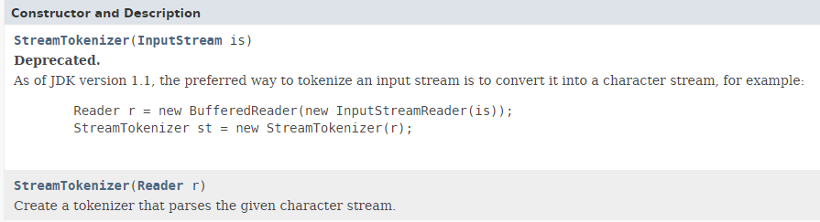
StreamTokenizer

Slide 3
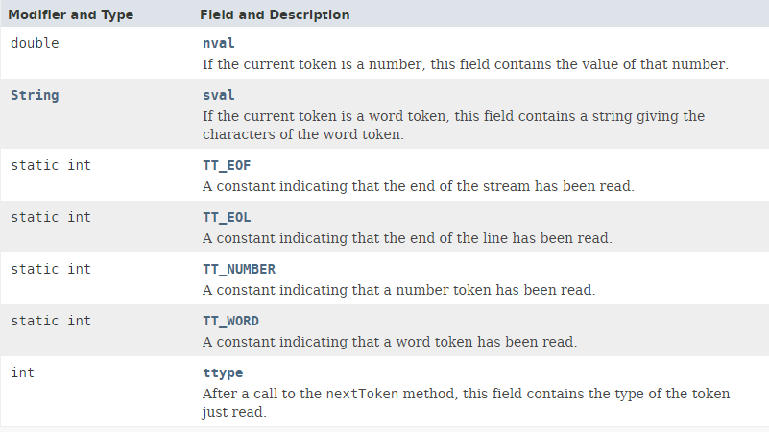
StreamTokenizer
ttype | The type of token read (word, number, end of line)
sval | The string value of the token, if the token was a string (word)
nval | The number value of the token, if the token was a number

Slide 4
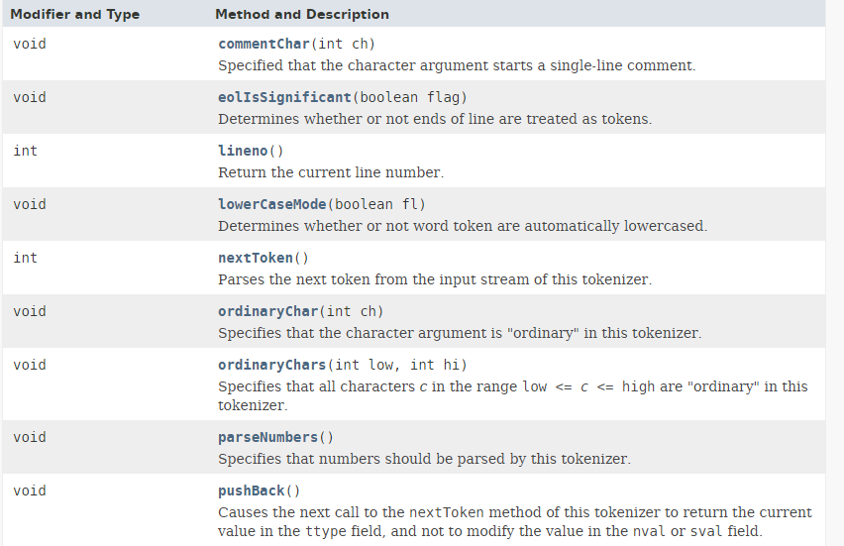
StreamTokenizer

Slide 5
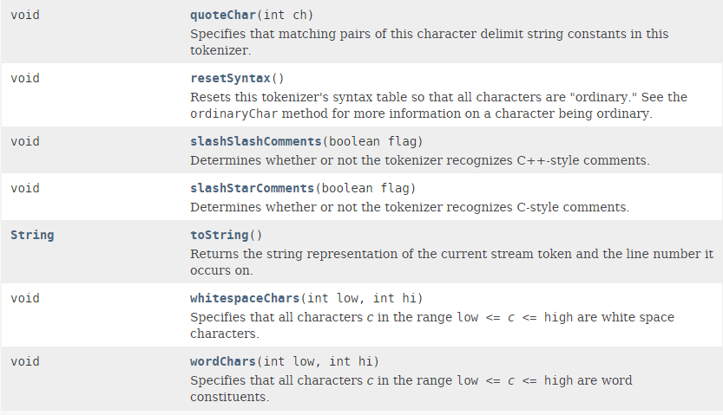
StreamTokenizer

Slide 6
StreamTokenizer
https://docs.oracle.com/javase/8/docs/api/java/io/StreamTokenizer.html

